Slide 1
Fake News Detection Using Machine Learning A Data Science Approach to Combat Misinformation
Presented by Vasavi Kullanakoppal

Slide 2

Introduction - Misinformation is eroding public trust and influencing decisions. - Manual fact-checking is not scalable.
GOAL
Build an automated system using ML to detect fake news.

Slide 3

Background and Motivation
Social media has accelerated news spread.
Fake news became a focus during the 2016 U.S. election.
Need for scalable, trustworthy detection methods.

Slide 4
Dataset Overview - Labeled news articles (Fake = 0, Real = 1)
Fields: text, label, publication_date
Cleaned and preprocessed text
Data Preparation
Text tokenization, stop word removal, punctuation stripping
Added feature: article length
TF-IDF vectorization for modeling

Slide 5
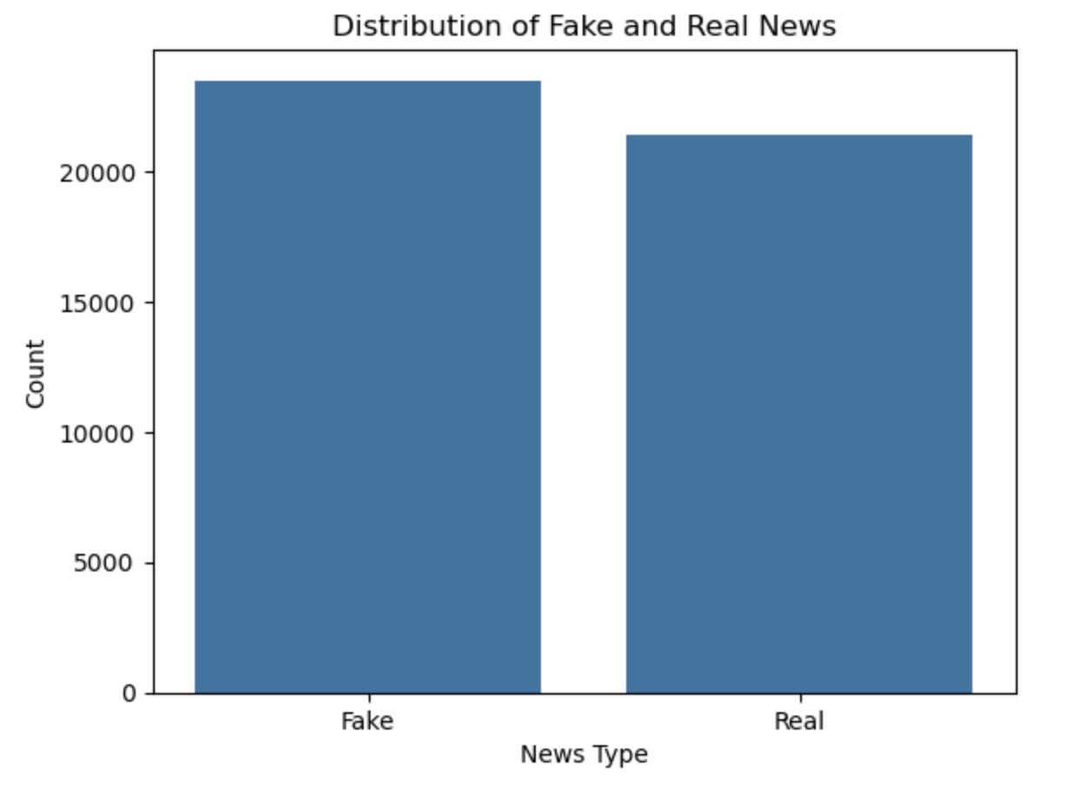
EDA/ Data Visualizations
Balanced distribution of Fake vs. Real

Slide 6
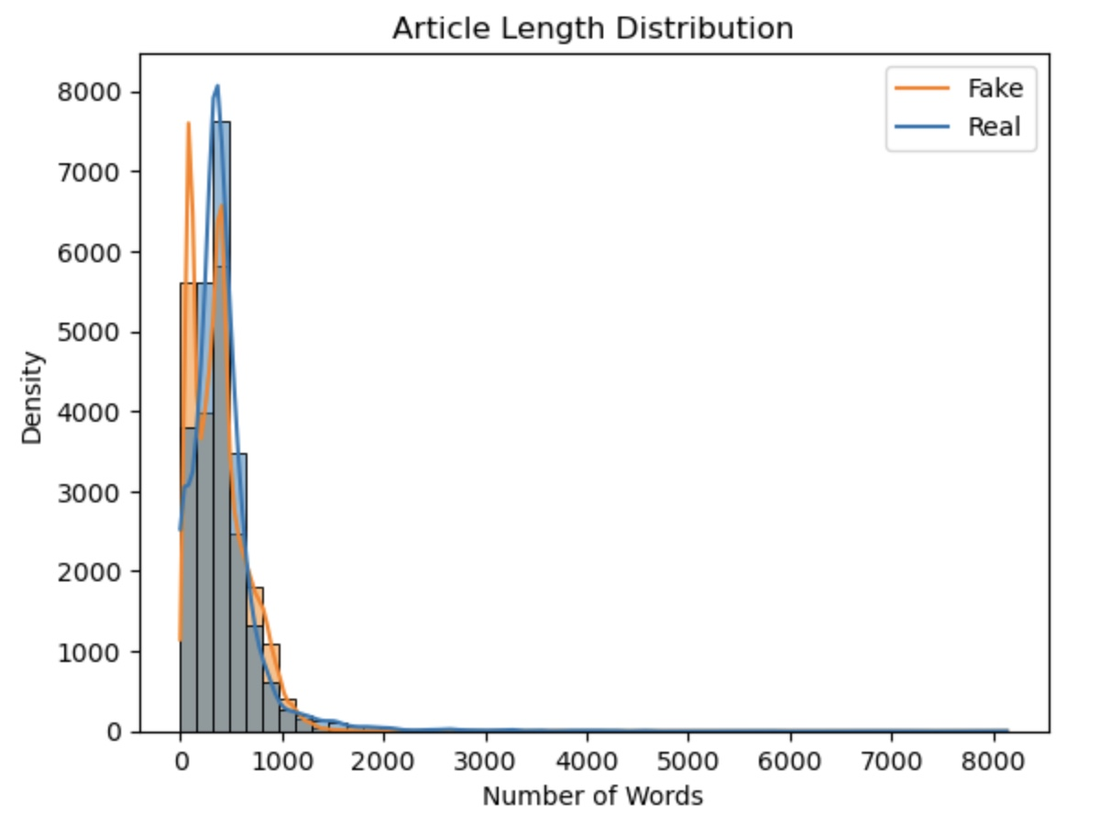
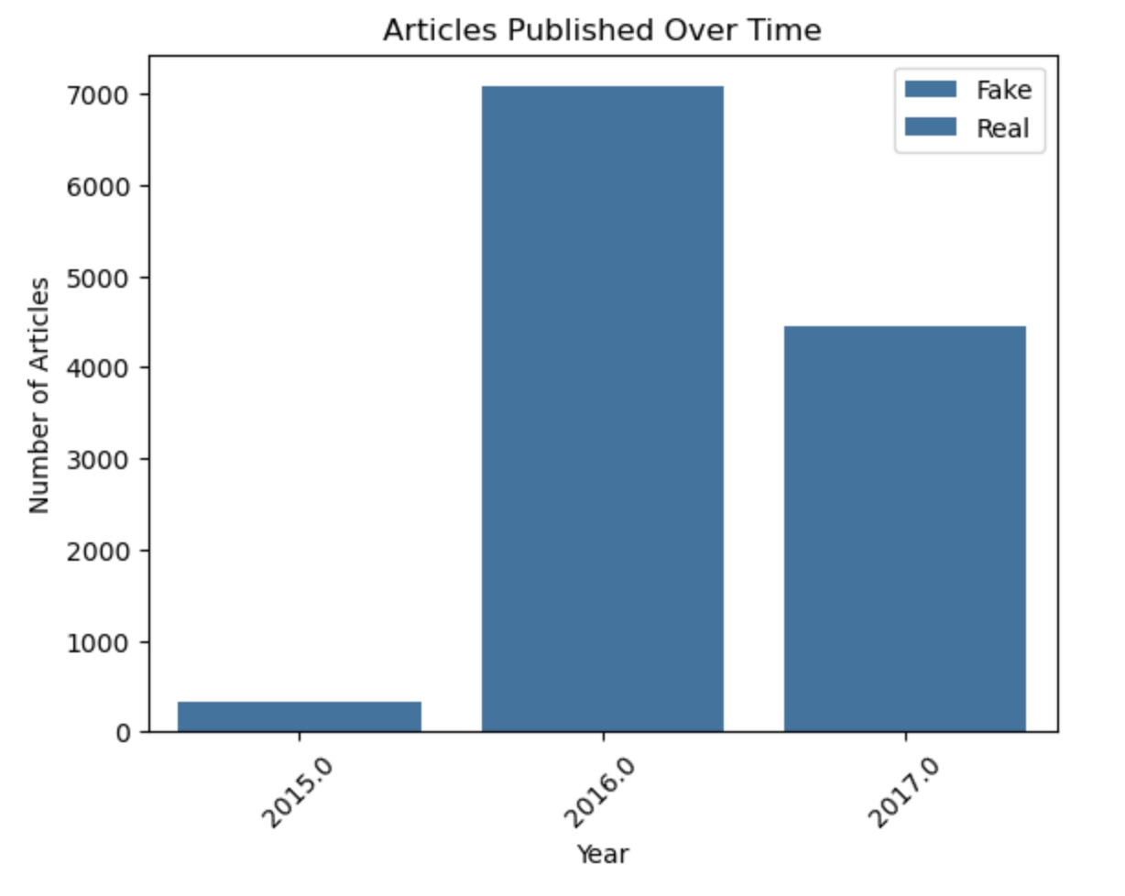
Fake articles tend to be shorter
Peak article activity in 2016

Slide 7
Modeling Approach
Supervised learning (train-test split: 80/20)
Algorithms: Logistic Regression
TF-IDF as input features

Slide 8

Evaluation Metrics
Accuracy, Precision, Recall, F1-score, ROC-AUC
Balanced performance across both classes

Slide 9
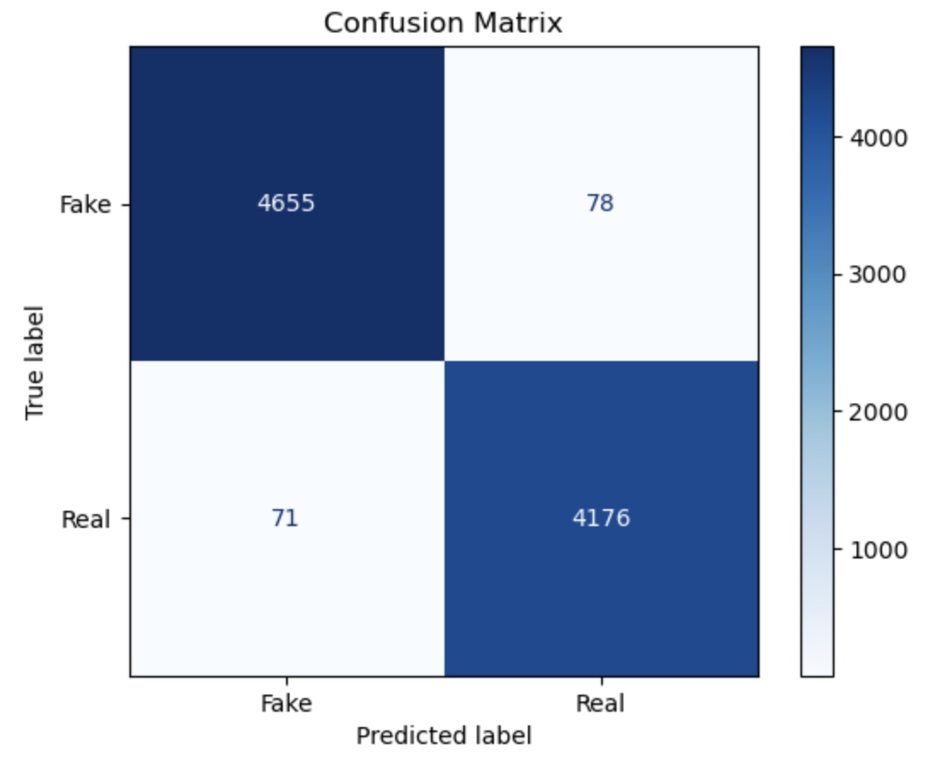
Confusion Matrix

Slide 10
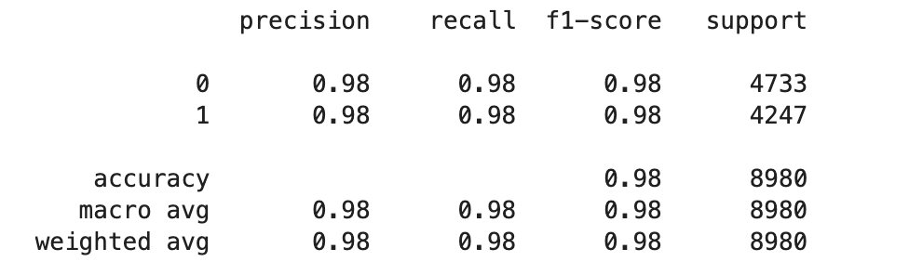
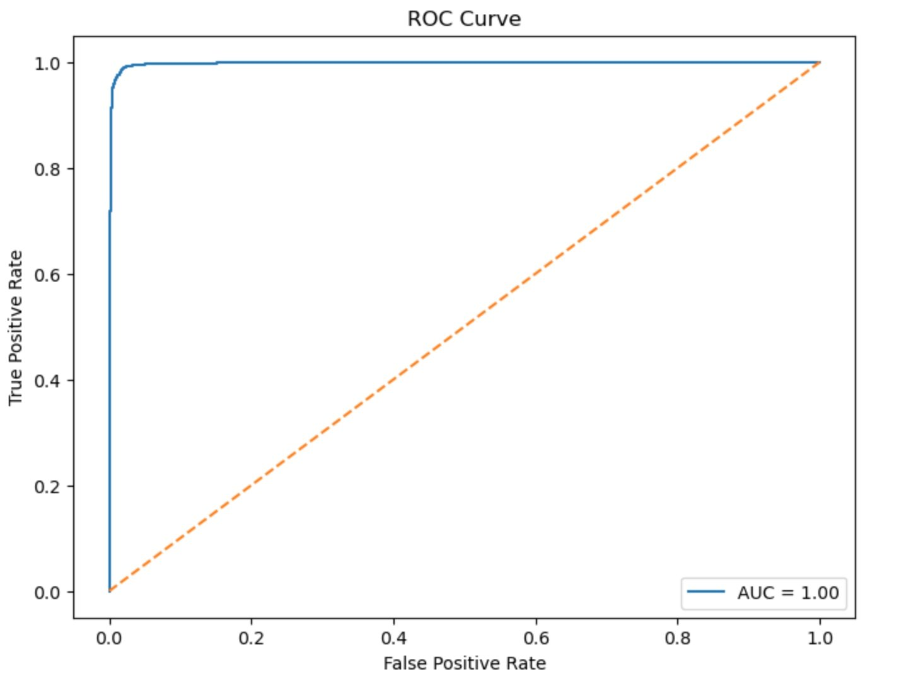
Classification Report and ROc
Accuracy: 98%
Precision/Recall: 0.98 for both Fake and ReaL AUC = 1.00 (perfect class separability)

Slide 11

Conclusion
Model performs exceptionally well on all metrics
Robust, scalable, and practical for real-world use

Slide 12
Challenges & Limitations
Detecting satire/opinion-based articles
Data limited to 2015–2017
Bias and evolving misinformation patterns

Slide 13
Future Applications
Real-time classification tools (browser plugins, CMS)
Educational applications and fact-checking integration
Multilingual expansion
Recommendations
Retrain regularly with updated data
Add metadata (author/source credibility)
Introduce user feedback loop

Slide 14
Ethical Considerations
Avoid misuse and over-censorship
Transparency and fairness
Compliance with privacy regulations
Implementation Plan
Finalize model and deploy in cloud
Monitor performance and user feedback
Schedule regular retraining

Slide 15
FAQ – Audience Questions
Accuracy in real-time? Around 98%, comparable to test data. ​
Can it detect satire? No, satire mimics real news and needs separate training. ​
Retraining? Recommended every 6–12 months. ​
Bias? Possible if the data is unbalanced; mitigated via audits. ​
Key features? TF-IDF scores, sensational words, article length. ​
Gamed or bypassed? Yes, but mitigated by updates and adversarial defenses. ​
Multilingual support? Currently English-only; other languages need new data. ​
Prediction transparency? Yes, with LIME/SHAP tools. ​
Ethical safeguards? Bias audits, transparency, GDPR compliance. ​
Scalability? Very high—can be cloud-deployed and containerized.

Slide 16
Thank you

